Slide 3
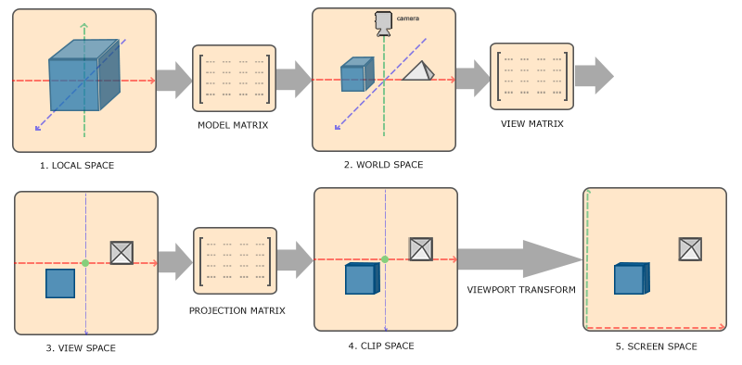

Slide 4
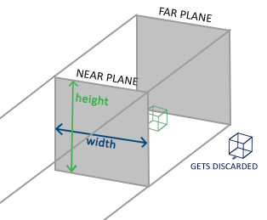
float left = 0.0f;
float right = (float)width;
float bottom = 0.0f;
float top = (float)height;
float depthNear = 0.1f;
float depthFar = 100.0f;
Matrix4.CreateOrthographicOffCenter(left, right, bottom, top, depthNear, depthFar);

Slide 5
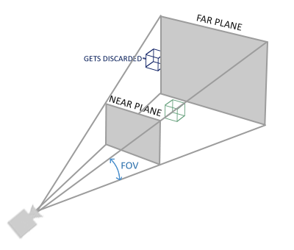
float fovy = MathHelper.DegreesToRadians(45.0f);
float aspect = (float)width / (float)height;
float depthNear = 0.1f;
float depthFar = 100.0f;
Matrix4.CreatePerspectiveFieldOfView(fovy, aspect, depthNear, depthFar);

